Slide 1
“Enhancing Visual Realism in Text-to-Image Synthesis through Stable Diffusion Techniques: Impact and Application Analysis”
Patryk Siczek
43225
Management and Artificial Intelligence
Aleksandra Przegalińska-Skierkowska, PhD

Slide 2
Introduction
Text-to-image synthesis
Process of generating realistic images from textual descriptions or prompts.
Text-to-image synthesis has gained increasing attention due to its potential applications in various fields, such as art, design, advertising, e-commerce, and entertainment.
It enables us to bridge the gap between language and vision, unlocking new possibilities for creative expression and communication.
I will analyze the benefits, challenges, and practical consequences of Stable Diffusion by reviewing current literature, evaluating case studies, and applying qualitative and quantitative research methods.
Objectives:
Impact of enhancing visual realism within text-to-image generation.
Applications of text-to-image generation.
Benefits and drawbacks of this technology.
Significance and relevance of this research:
Recognition by society.
Familiarity with new advancements.
Ethical considerations

Slide 3
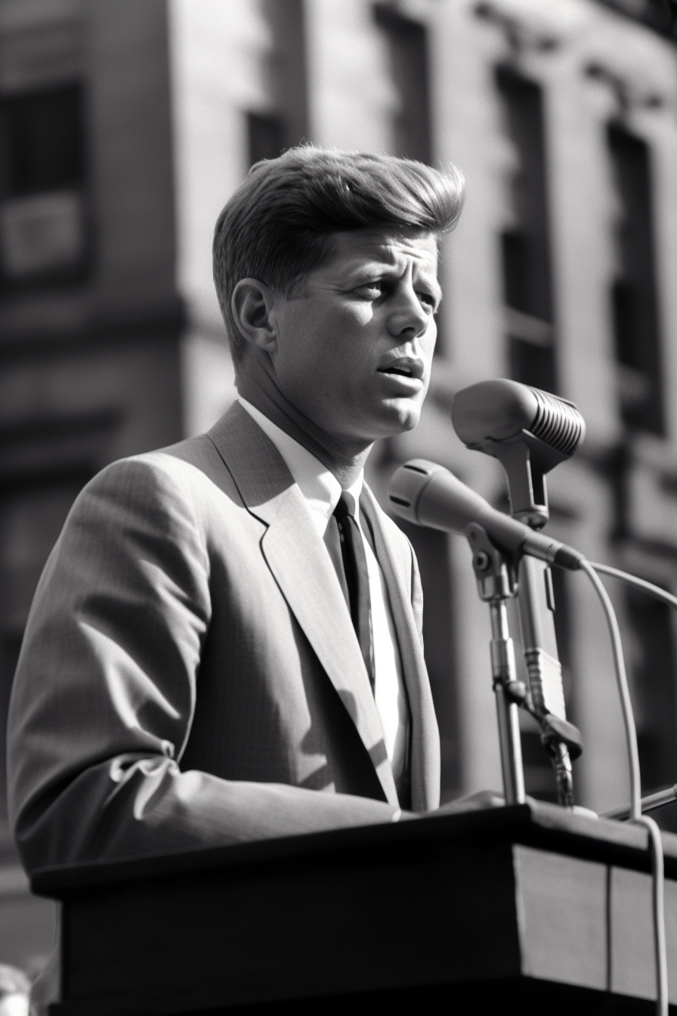

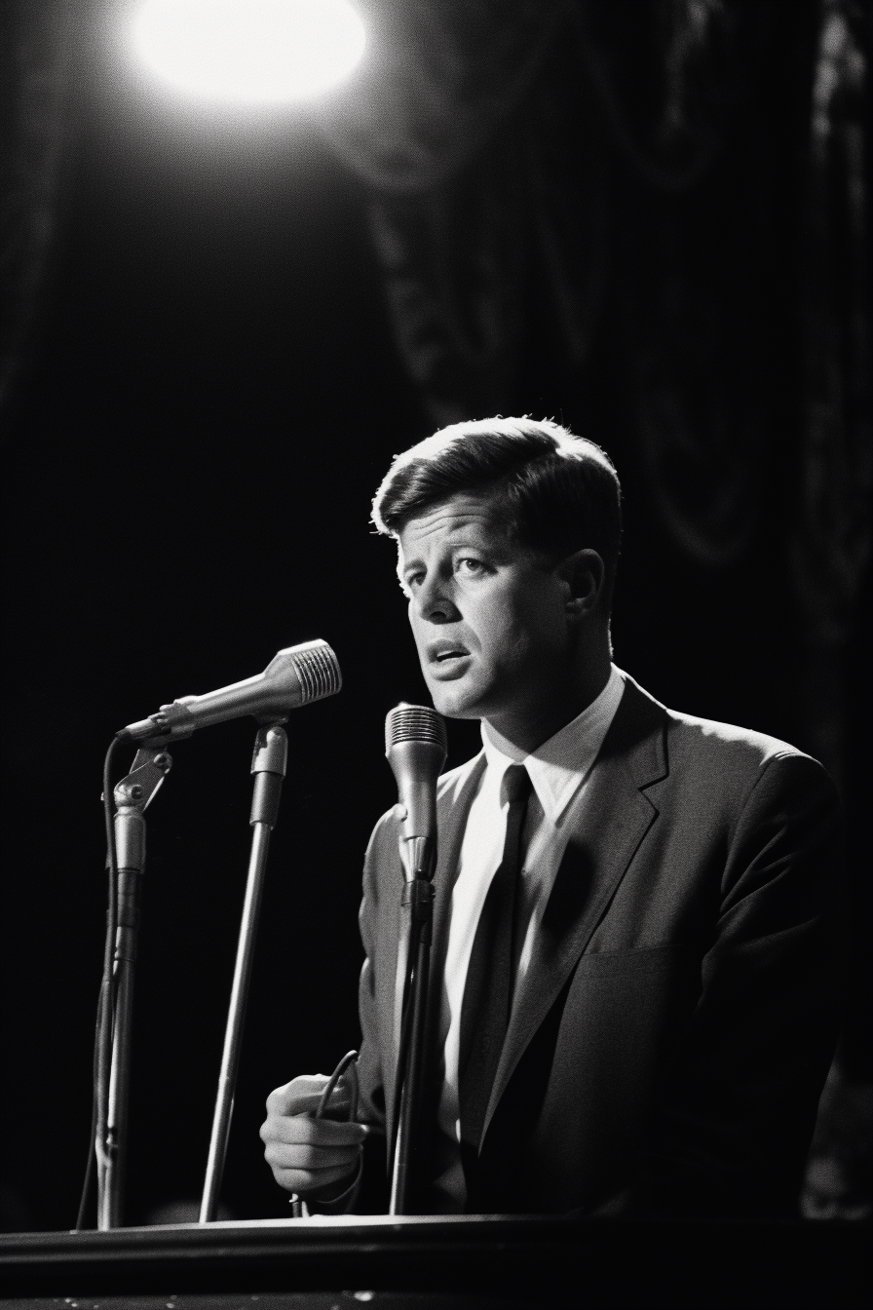

Theory behind text-to-image generation
Variational Autoencoders (VAEs) used in signal analysis such as anomaly detection, security analytics, drug discovery targets etc.
Generative Adversarial Networks (GANs) used for generating multimedia such as deepfakes, voicovers, realistic images, dubbing in movies etc.
Stable Diffusion models

Slide 4
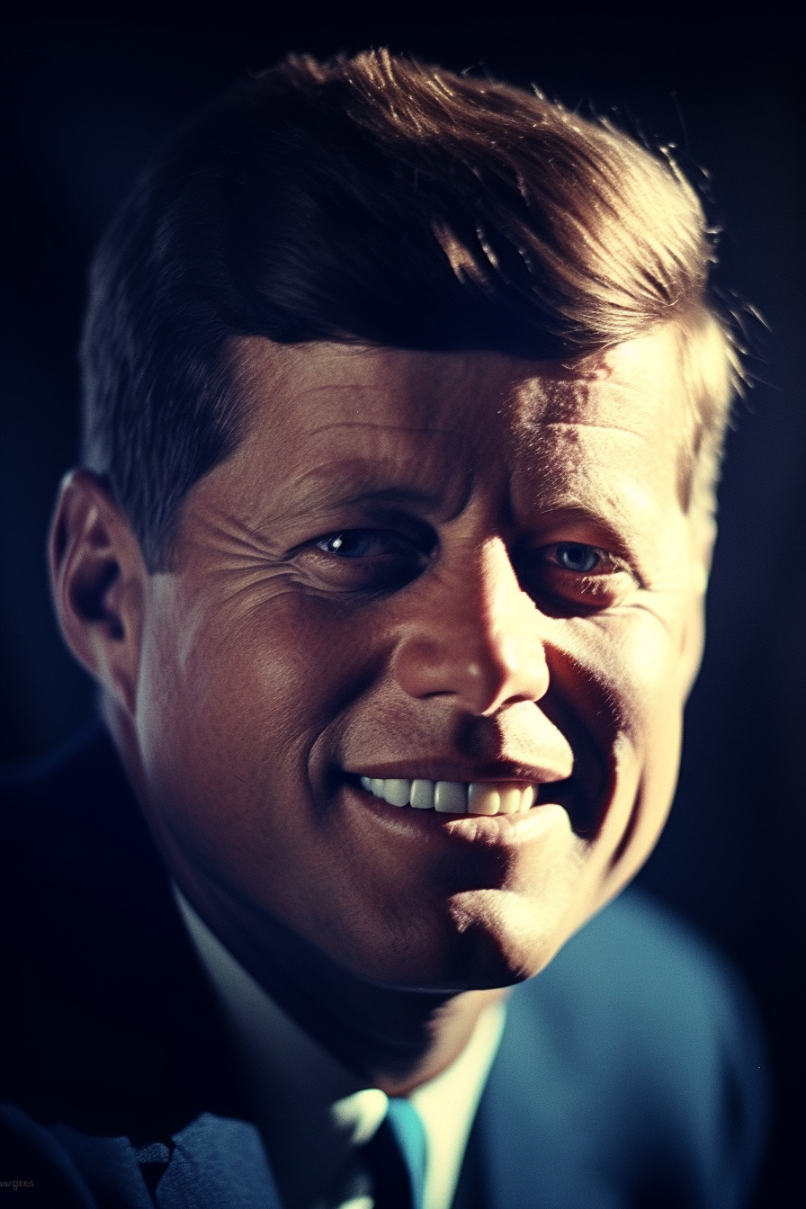
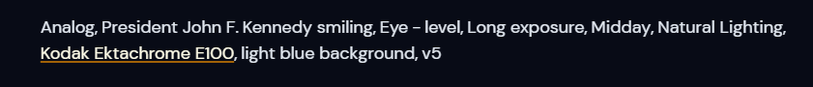
Stable Diffusion
Traditional generative models frequently struggle with visual stability and diversity. Stable Diffusion approaches seek to address these constraints by using a diffusion process during training, gradually refining output images to capture fine-grained details and improve realism.
The diffusion technique involves adding Gaussian noise to the generated images iteratively and gradually decreasing the noise intensity.
Stable Diffusion has gained popularity due to its potential to improve picture synthesis quality and diversity. It has applications in sectors such as virtual reality, gaming, and content development.

Slide 5
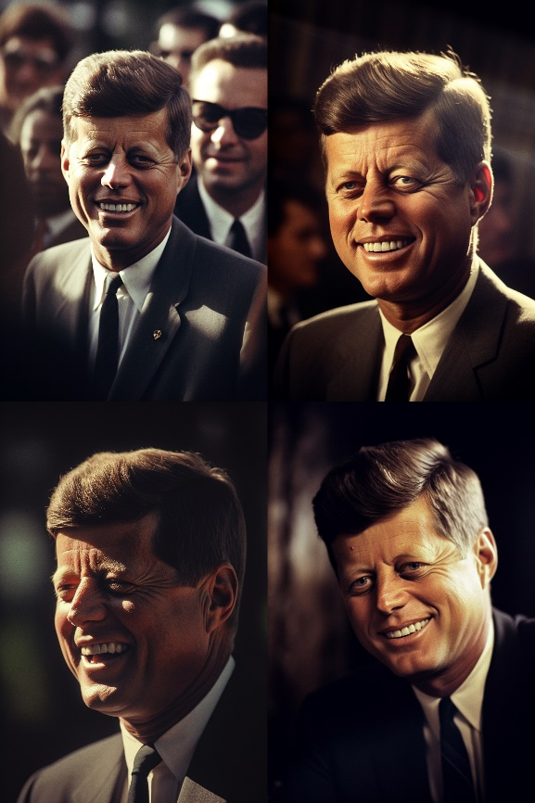
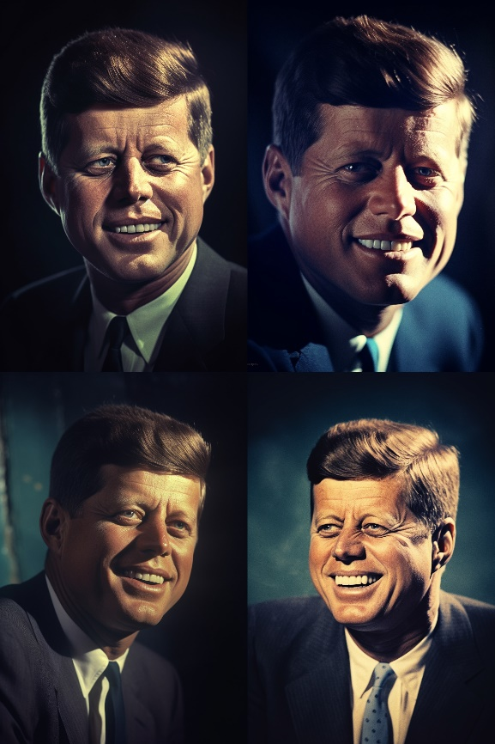
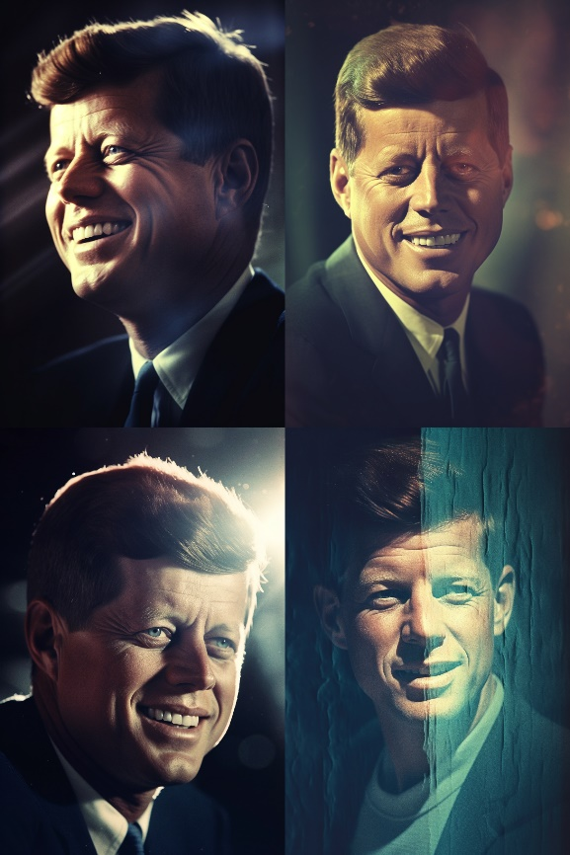
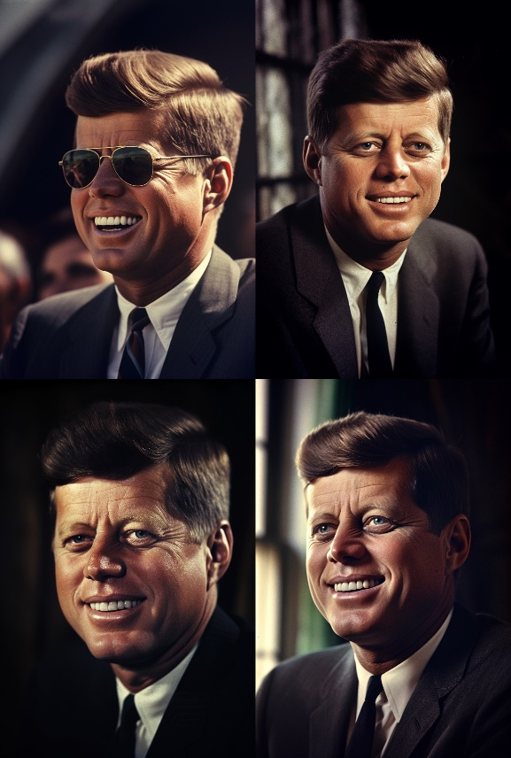
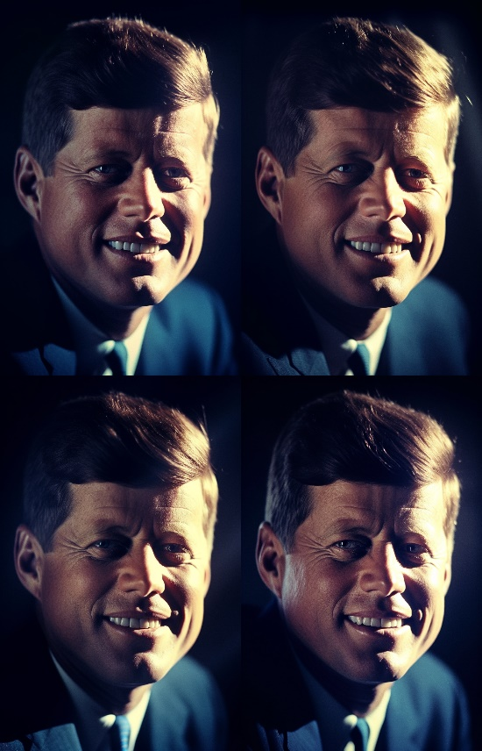
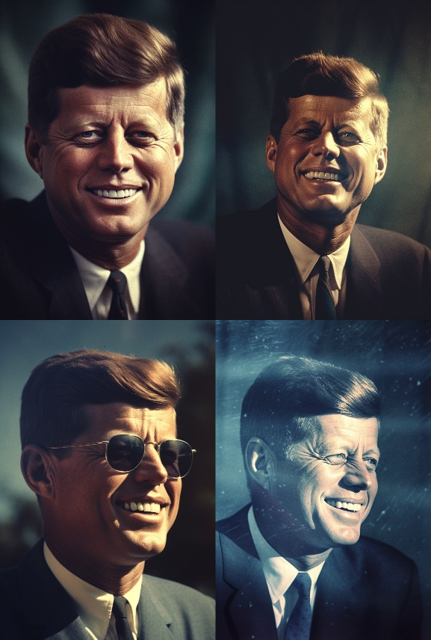
Training and optimization
To create and effectively use diffusion models, it is essential to focus on training and optimization. These actions are critical in helping the models learn from data, improve their parameters, and produce exceptional images.
To make the model better suited for a specific task it undergoes a process called fine-tuning. This involves training the model on a dataset of text and images, allowing it to learn how to generate images based on the provided text. The model's parameters are adjusted through optimization to minimize any differences between the generated images and the actual images.
Model is taught using various and inclusive datasets, which helps it create images that match the desired features, styles, or meaning as instructed by conditioning mechanisms.

Slide 6
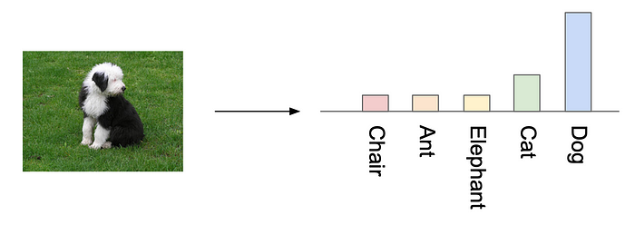
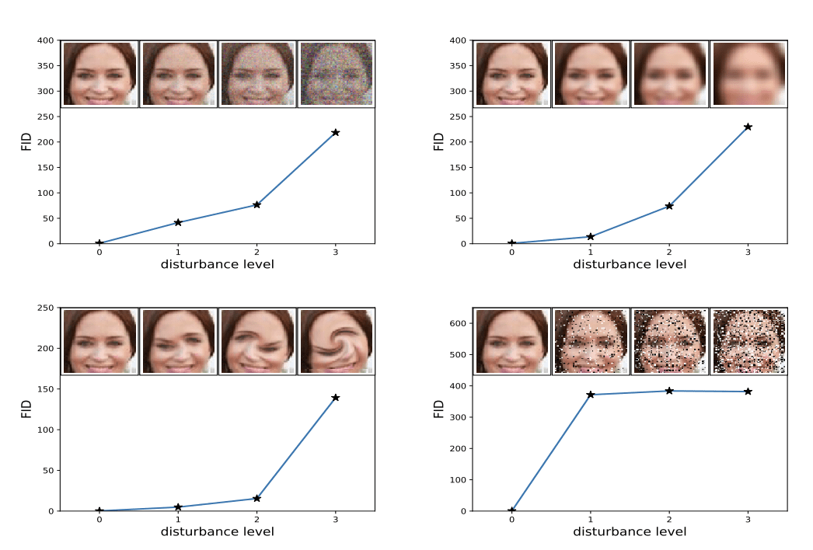
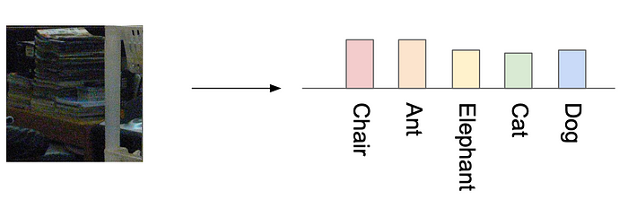
Evaluation metrics
The Inception Score (IS) is a common way to measure how good and varied the images produced by a generator are.
The Fréchet Inception Distance (FID) is a commonly used measure in evaluating the quality of generated images.
https://medium.com/octavian-ai/a-simple-explanation-of-the-inception-score-372dff6a8c7a
https://medium.com/octavian-ai/a-simple-explanation-of-the-inception-score-372dff6a8c7a

Slide 7
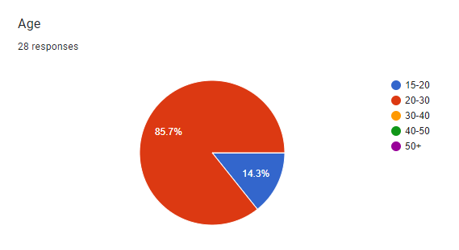
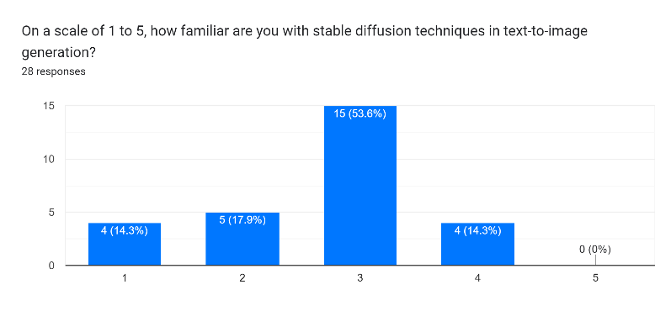
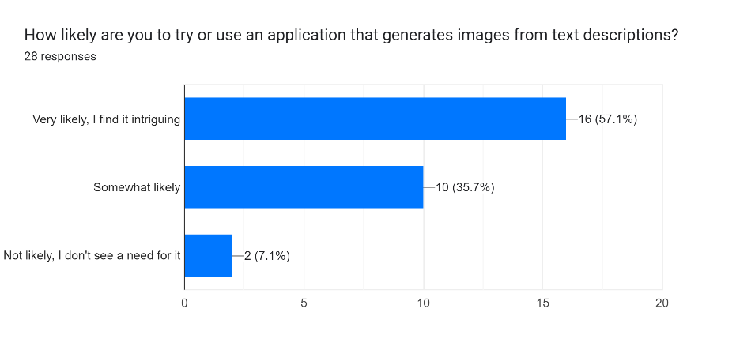
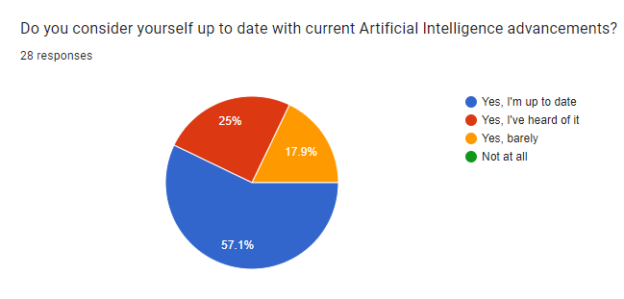
Questionnaire analysis, diagnosis and key findings

Slide 8
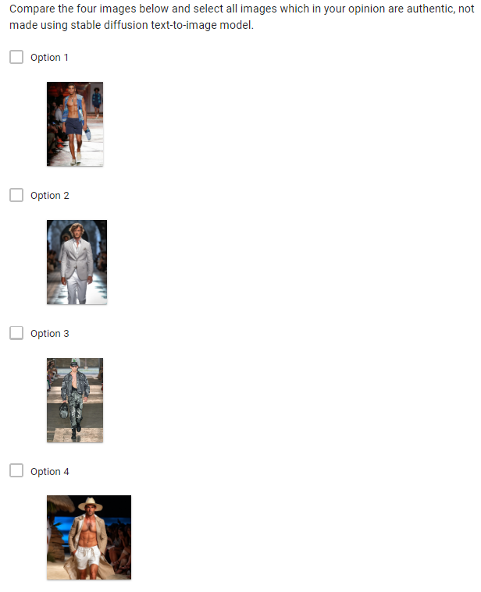
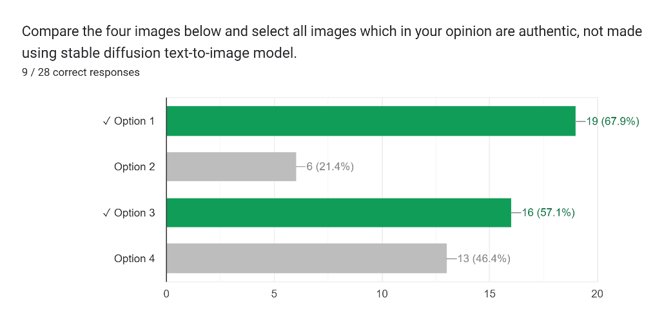
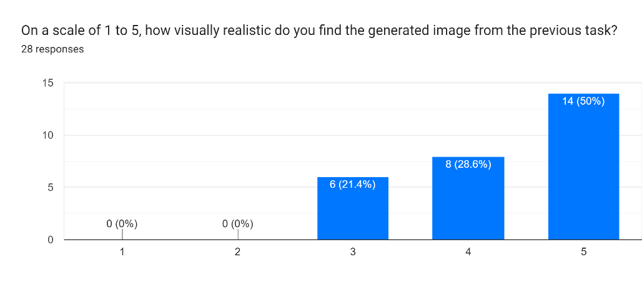
Key findings
1) Evaluation of Image Authenticity - Only 9 out of 28 responses (32%) correctly marked all authentic pictures identified by comparing them with generated ones thus providing intuitive information that differentiating between genuine versus nullified images could be perceived challenging.

Slide 9
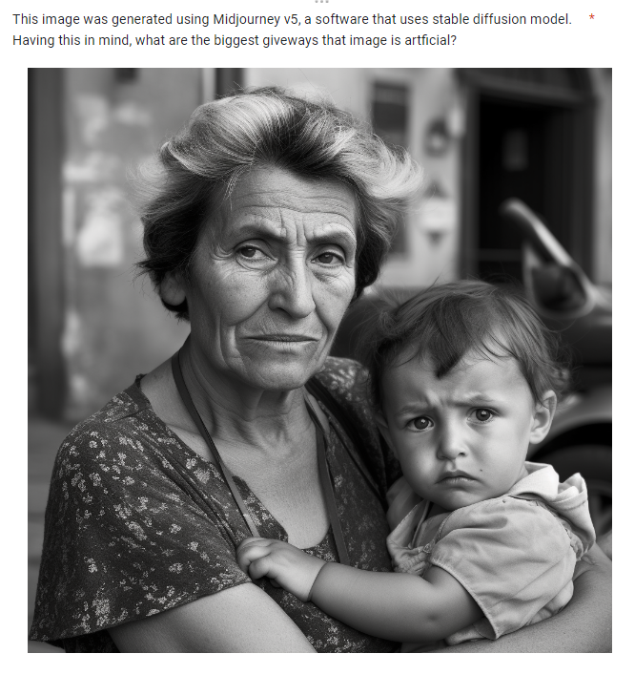
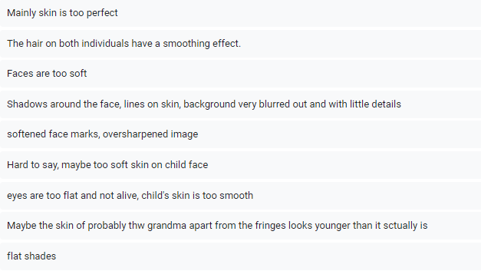
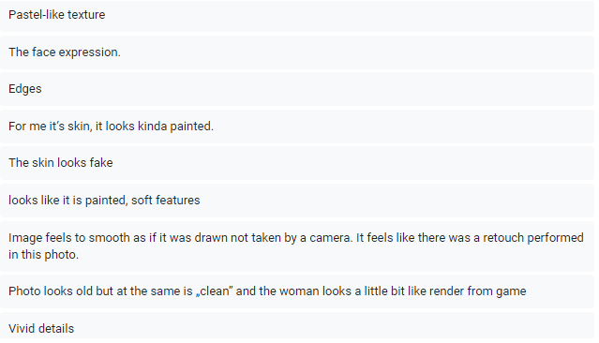
2) Perception of Artificiality - Using the stable diffusion model, participants marked the elements that gave away an image's artificial nature. discovered key factors included overly perfect skin, soft features, smoothed-out hair, lack of details and unrealistic wrinkles; these identified artificial elements mirror almost all text-to-image synthesis common challenges.

Slide 10
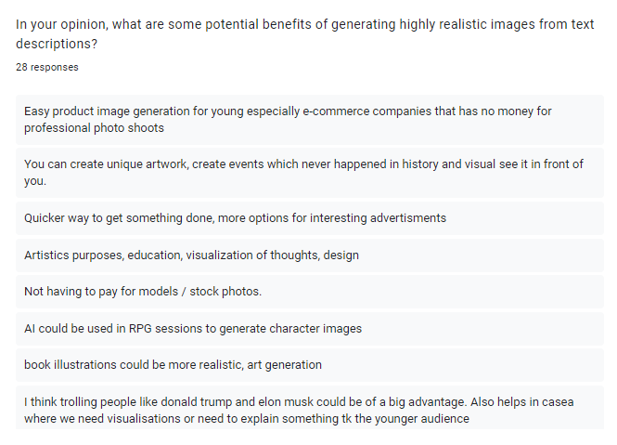
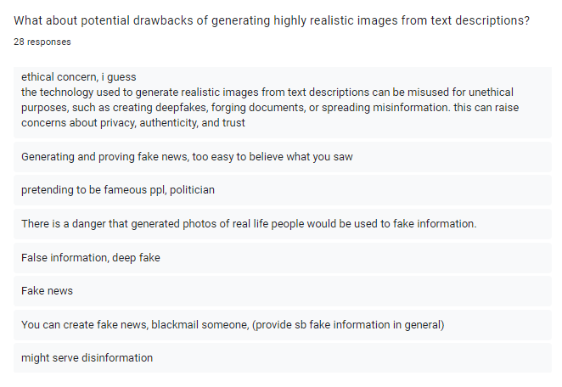
3) Potential Benefits - These ranged from cost-cutting measures for businesses to ease of artwork creation; visualization tips for historical events; quicker execution tasks; better communication through visual representations in various fields such as education, marketing, ads, book illustrations, design.
4) Potential Drawbacks - Among these concerns lies the dissemination of fake news, manipulating and falsifying evidence, spreading misinformation, misusing deepfakes, substituting authentic photographers and artists while also raising privacy issues alongside potentially producing inappropriate or violent outcomes.

Slide 11
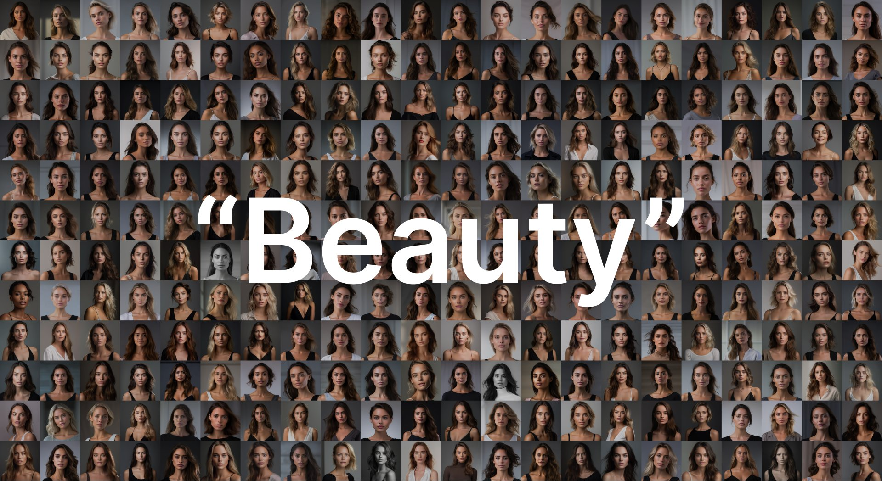
Conclusions
Cost Reduction: Text-to-image synthesis reduces the reliance on expensive photo shoots and stock images, making it cost-effective for businesses to generate custom visual content.
Improved Visual Communication: Highly realistic images generated from text descriptions facilitate clear and intuitive visual communication, enhancing understanding and engagement.
Enhanced Creativity: Text-to-image synthesis empowers artists, designers, and storytellers to bring their textual ideas to life visually, fostering creativity and pushing the boundaries of expression.
Ethical Considerations and Responsible Development: As text-to-image synthesis becomes more powerful, it is crucial to address ethical concerns, such as the potential for misuse in creating deepfakes or spreading misinformation. Responsible development practices and regulations should be considered to ensure the responsible use of this technology.
‘We all know Midjourney loves to create perfect humans. But beauty is subjective, and that’s the beauty of us – we’re not perfect.’
Brunette-Hair: 75% (197) Blond-Hair: 23% (61) Red-Hair: 2% (6) Other: 0%
Light Eyes: 68% (180) Dark Eyes: 32% (84)
Light skin 86% (227) Tan skin 11% (29) Dark skin 3% (8)
Younger-Aged People: 100% Middle-Aged People: 0%
Wrinkles: 0% Scars: 0% Glasses: 0%
Nicolas Neubert (@iamneubert)
https://twitter.com/iamneubert/status/1660379183787196416?s=20
‘Editorial Portrait, Beautiful Woman, Photoshoot Lighting, Detailed Face, Black Background, Shot on Sony Alpha a7 III Camera With a Sony FE 24-105mm f/4 G OSS Lens —style raw and generated 264 Portraits and made an analysis.’

Slide 12
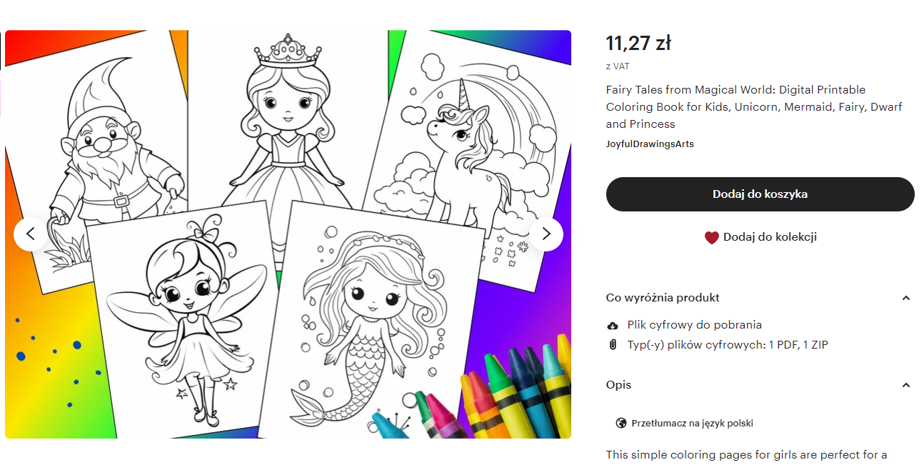
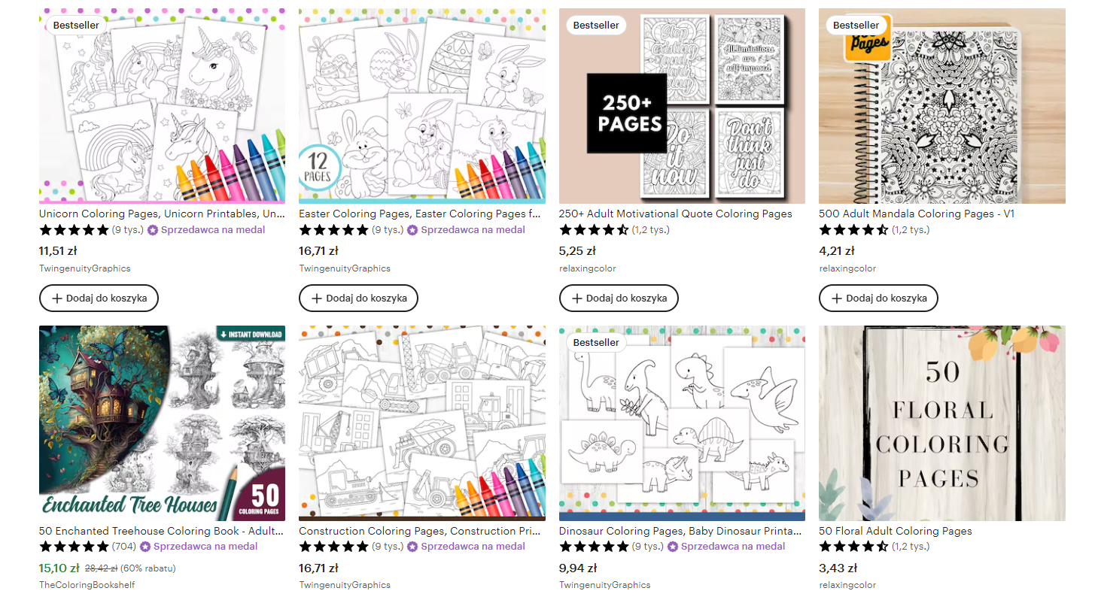
Industry applications
Advertising and Marketing: Text-to-image synthesis offers cost-effective solutions for generating visual assets, reducing the need for professional photo shoots and stock images.
Design and Fashion: Creation of personalized and customized visual content, facilitating product visualization, virtual try-on experiences, and interior design simulations.
Education and Training: Highly realistic images generated from text descriptions can enhance educational materials, immersive simulations, and virtual training environments.
Accessibility and Inclusivity: Text-to-image synthesis can assist individuals with visual impairments by providing visual descriptions and enhancing accessibility to visual content.

Slide 13
Bibliography
Lawton, G. (2023) Gans vs. Vaes: What is the best generative AI approach?: TechTarget, Enterprise AI. Available at: https://www.techtarget.com/searchenterpriseai/feature/GANs-vs-VAEs-What-is-the-best-generative-AI-approach (Accessed: 15 June 2023).
Mack, D. (2019) A simple explanation of the inception score, Medium. Available at: https://medium.com/octavian-ai/a-simple-explanation-of-the-inception-score-372dff6a8c7a (Accessed: 15 June 2023).
Neubert, N. (2023) ⚗️ experiment: Niji ‘Beauty’ in #midjourneythis post is part 2 of analyzing how Midjourney defines beauty in its output. in this series, I’ll explore how Midjourney interprets the concept of beauty and what challenges the model still faces with this subjective topic.for the... pic.twitter.com/0wwy32nwzb, Twitter. Available at: https://twitter.com/iamneubert/status/1660379183787196416?s=20 (Accessed: 15 June 2023).
Essentialist (no date) essentialist MIDJOURNEY 51 QUALITY and its view on beauty Comments. Available at: https://essentialist.ai/midjourney-5-1-quality-and-its-view-on-beauty/ (Accessed: 15 June 2023).
Essentialist (no date b) essentialist MIDJOURNEY 51 QUALITY and its view on beauty Comments. Available at: https://essentialist.ai/midjourney-5-1-quality-and-its-view-on-beauty/ (Accessed: 15 June 2023).
Fan, S. W. R. N. T.-T. T. C. Y.-C. H. J. S. &. K. B. L., 2014. Human Perception of Visual Realism for Photo and Computer-Generated Face Images. In: ACM Transactions on Applied Perception. s.l.:Association for Computing Machinery, p. 1–21.

